Slide 1
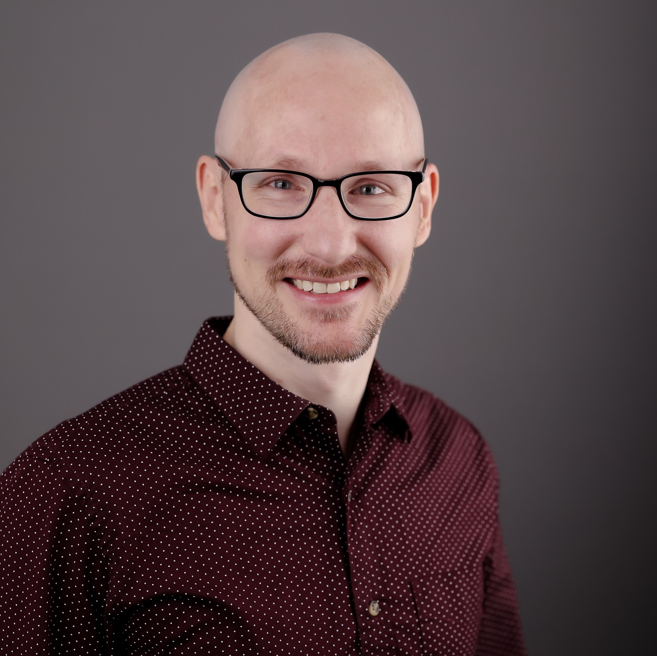
Jeff Burt Director — Cloud & Product
Email
jeff.burt@thebridge.com
Location
DFW, Texas
Mobile
(214) 263-7778
Jeff joined The Bridge in March 2024. He has previously worked both in industry and at several technology consulting firms where has led high-performing teams in delivering technology strategy and solutions across a wide range of customers in many industries.
EXPERIENCE
Industry Experience
Financial Services | Agriculture | Healthcare | Staffing | Legal | Logistics | Real Estate | Marine Services
Enterprise Technical Strategy | Agriculture
Led technical efforts on multiple tech strategy engagements with a $4b+ agriculture company, advising on both customer-facing products and internal enterprise architecture
Designed architecture for future-state data platform to support recommended enhancements to digital product portfolio and built multi-year roadmap for implementation
Advised on enterprise architecture to support new and consolidated LTO and OTC processes, building near and long-term roadmaps for major initiatives and implementation work
Cloud Platform Buildout | Real Estate
Served as principal architect, directly responsible for leading DevOps and backend teams
Defined the overall architecture / direction of all infrastructure and backend development efforts
Heavily involved in project management and product management roles, helping to define the product, the scope, and the roadmap to MVP release
Architected / built full DevOps pipelines to build/release/deploy infrastructure and microservices
Architected Azure-hosted, .NET Core-based platform, making use of technologies like API Management, Azure Functions, Cosmos DB, Service Bus, and Azure Cognitive Search to build performant, scalable backend APIs for a successfully launched consumer portal
BACKGROUND
Functional Skills
Software Architecture, Design Patterns, Software Engineering Leadership, Full-Stack Development,
Agile Project Management, DevOps, Tech Strategy, Digital Transformation & Innovation, GenAI
Qualifications
Technology leader focused on Cloud & Product engineering. Jeff has served as lead architect on numerous cloud, software, and advisory projects, including Enterprise Technical Strategy for an agriculture client and a Cloud Platform Buildout for a real estate client as recent examples.

Slide 2

Email
jeff.burt@thebridge.com
Location
DFW, Texas
Mobile
(214) 263-7778
Jeff joined The Bridge in March 2024. He has previously worked both in industry and at several technology consulting firms where has led high-performing teams in delivering technology strategy and solutions across a wide range of customers in many industries.
Jeff Burt Director
Cloud & Product

Slide 3
Jeff Burt Director — Cloud & Product
Email
jeff.burt@thebridge.com
Mobile
(214) 263-7778
Location
DFW, Texas
BACKGROUND
EXPERIENCE
Functional Skills
Software Architecture, Design Patterns, Software Engineering Leadership, Full-Stack Development,
Agile Project Management, DevOps, Tech Strategy, Digital Transformation & Innovation, GenAI
Qualifications
Technology leader focused on Cloud & Product engineering. Jeff has served as lead architect on numerous cloud, software, and advisory projects, including Enterprise Technical Strategy for an agriculture client and a Cloud Platform Buildout for a real estate client as recent examples.
Industry Experience
Financial Services | Agriculture | Healthcare | Staffing | Legal | Logistics | Real Estate | Marine Services
Enterprise Technical Strategy | Agriculture
Led technical efforts on multiple tech strategy engagements with a $4b+ agriculture company, advising on both customer-facing products and internal enterprise architecture
Designed architecture for future-state data platform to support recommended enhancements to digital product portfolio and built multi-year roadmap for implementation
Advised on enterprise architecture to support new and consolidated LTO and OTC processes, building near and long-term roadmaps for major initiatives and implementation work
Cloud Platform Buildout | Real Estate
Served as principal architect, directly responsible for leading DevOps and backend teams
Defined the overall architecture / direction of all infrastructure and backend development efforts
Heavily involved in project management and product management roles, helping to define the product, the scope, and the roadmap to MVP release
Architected / built full DevOps pipelines to build/release/deploy infrastructure and microservices
Architected Azure-hosted, .NET Core-based platform, making use of technologies like API Management, Azure Functions, Cosmos DB, Service Bus, and Azure Cognitive Search to build performant, scalable backend APIs for a successfully launched consumer portal

Slide 4










 | USE OVER DARK BACKGROUND | USE OVER LIGHT BACKGROUND
STRATEGY & ADVISORY
DATA & AI
EXPERIENCES
CLOUD & PRODUCT
ACCELERATION

